Slide 1
Join the Cloud!
Robert Nordmark and Brian Burkhart
Director of Network Services
Assistant Director Network Systems

Slide 2
Included Services
These services are available to you for no additional cost if you are a customer of the OneNet network.

Slide 3
Web Hosting
No pre-defined limit on the space or bandwidth used if you're following the AUP
Uses cPanel for straightforward control of site options
The Installatron plugin makes installing many open-source web applications super-easy
www.onenet.net is hosted on cPanel alongside member sites
Web and email hosting for non-Internet access customer is $300

Slide 4
Email Hosting
Unlimited email accounts
IMAP or POP3 for incoming mail
SMTP for outbound mail
WebMail
Calendar
Address Book
438 domains with 140,000 accounts

Slide 5
Anti-SPAM
Based on an open-source project called Maia Mailguard
Your URL is https://yourdomain/spam
Provides virus and spam detection and quarantine
Per-user sensitivity settings and white/black lists

Slide 6
Domain Name Service Hosting
You can manage your DNS records through your cPanel account (even if we don’t host your web site)
We can make the DNS changes for you
Free registration of lib.ok.us, k12.ok.us, cc.ok.us, and many others
No cost for .k12.ok.us domains, even if you’re not a OneNet subscriber

Slide 7
Video Conferencing
Multi-Point high-definition conferencing
Conference Recording
Live Streaming
Mobile client available (PC, Mac, iPad)

Slide 8
Additional Services
These services are offered on a cost recovery basis. You pay what it costs us to provide the service.

Slide 9
Storage
Whether you need a good place to keep a copy of your data safe, or if you need primary storage, we probably have a solution
IBM Tivoli Storage Manager
IBM N-Series (NetApp) Storage
SAM-FS

Slide 10
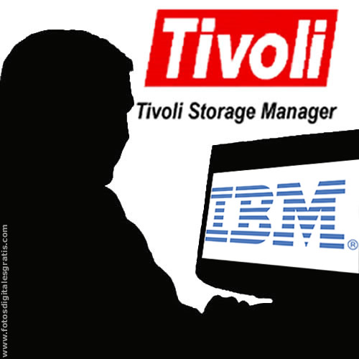
TEXTEXTEXTEXTEXTEXT
Traditional server backup
Client installed on your mission-critical server
Your data is automatically backed up to our OKC and/or Lawton storage systems
Cost is $15/50G/year for total space used in the backup system
One-time $500 setup fee per system covers license costs

Slide 11
TEXTEXTEXTEXTEXTEXT
Dedicated File Services
Great for use as a primary file server if you have a larger pipe
N-Series Snapmirror
Perfect DR backup solution if you're running IBM N-Series or NetApp storage
Mirror your data to one of OneNet's datacenters

Slide 12
Colocation
OKC Data Center Colocation
Redundant 10 Gig connections to OneNet core
Redundant UPS power with generator backup
$20 per rack unit per month
Perimeter Technology Center
Redundant 10 Gig connectivity to OneNet core
Contact PTC for more information

Slide 13
Learning Management Systems
Commercial LMS offerings
Hosted in OneNet's data center
Supported by Desire2Learn and Blackboard
Open-Source LMS
Can be run on OneNet's shared Web hosting service (free) or on a dedicated VM
We have members running it both ways
Forum-based support or commercial support offerings available

Slide 14
Mail Archiving
Email compliance archiving
Based on Tangent Datacove
This software is co-developed with the makers of MailArchiva
Can be used with or without our email service
Archives all messages in or out of your domain
Full text searching of messages and attachments
Unlimited retention as long as the mailbox archive subscription is current
Cost is $10 per mailbox per year

Slide 15
Virtual Infrastructure
Dedicated Virtual Machine
DR Backup (snapmirror to Tulsa) included
VMware High Availability included
ICB needs can be met
Virtual CPUs | RAM | Disk | Annual Cost
1 | 2G | 36G | $600
2 | 4G | 72G | $1100
4 | 8G | 144G | $2100

Slide 16
Network Virtualization
Robert Nordmark will now discuss our network virtualization offerings.

Slide 17
What is MPLS?
MPLS stands for “Multi-Protocol Label Switching”
MPLS is best summarized as a “Layer 2.5 Networking Protocol”
OneNet offers several types of network virtualization:
Layer 2 VPN’s
Point to Point
Point to Multipoint
Layer 3 VPN

Slide 18
Layer 2 VPNs
Layer 2 Pseudowire or VLL (Virtual Leased Line)
An emulated layer-2 point-to-point circuit, delivered over MPLS
Can be used to interconnect two different types of media:
For example, Ethernet to T1
Useful for migrating legacy transport to an MPLS network
Completely Circuit Technology Agnostic
Scales to extremely large deployments

Slide 20
Layer 2 VPLS
VPLS (Virtual Private LAN Service)
Creates an Ethernet multipoint switching service over MPLS
Used to link a large number of customer endpoints in a common broadcast
domain
Avoids the need to provision a full mesh of L2 circuits
Emulates the basic functions of a layer 2 switch:
Unknown unicast flooding
Mac learning
Broadcasts
Typically load-balancing friendly since the L2 Ethernet headers are examined and used, unlike L2 pseudowires where they are passed transparently

Slide 22
Layer 3 VPN
An IP-based VPN
Networks build virtual routing domains (VRFs) on their edge routers
Customers are placed within a VRF, and exchange routes with the OneNet router in a protected routing-instance.
Can support complex topologies and interconnect many sites
But can add a significant load to the service provider infrastructure
Typically seen in more enterprise environments
Signaled via BGP within the OneNet network

Slide 24
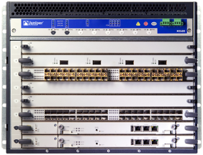
OneNet Virtualized Data Center
IBGP / OSPF
2
2
MC-LAG

Slide 27
OneNet Class Of Service
Expedited forwarding (EF)—Provides a low loss, low latency, low jitter, assured bandwidth, end-to-end service.
Assured forwarding (AF)—Provides a group of values you can define and includes four subclasses: AF1, AF2, AF3, and AF4, each with three drop probabilities: low, medium, and high.
Best effort (BE)—Provides no service profile. For the BE forwarding class, loss priority is typically not carried in a class-of-service (CoS) value, and random early detection (RED) drop profiles are more aggressive.
Network Control (NC)—This class is typically high priority because it supports protocol control.
Scavenger Class (SC) — Lowest Priority on traffic, If bandwidth is close to full packets are dropped.

Slide 28
Content Filtering Services
OneNet will provide a fast, economical, secure, and flexible web content filtering solution.
Centralized Solution –
OneNet will work with you to forward all your web traffic to one of OneNet’s centralized web filtering server.
Decentralized Solution –
OneNet will provide on-site customer premise eqipment. This solution will provide the customer more granularity in the web filtering.

Slide 29
QUESTIONS?

